Slide 1

Physical Therapy
Scheduling System...
Presented by:
B.Akshitha - 3BR22AI019
D.Ranjitha - 3BR22AI036
kavya.B - 3BR22AI081
P.keerthana- 3BR22AI083

Slide 2
Content:
Introduction
Features
Appointment booking
Patient information managment
Therapist availabity and scheduling
Feedback and rating
Algorithm
Conclusion

Slide 3
Introduction
In today's fast-paced healthcare environment, efficient scheduling plays a crucial role in ensuring that patients receive the timely care they need to support their rehabilitation journey
Physical therapy, a component of rehabilitation, involves exercising and manipulating the body with an emphasis on the back, upper arms, and legs. It can improve joint and muscle function, helping people stand, balance, walk, and climb stairs better.

Slide 4
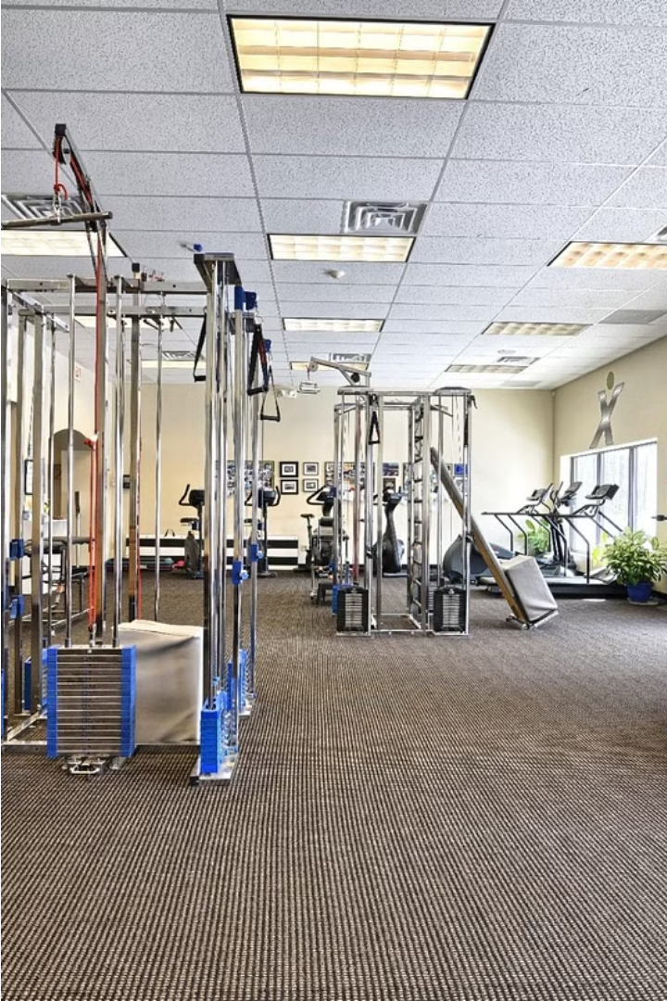

FEATURES:
Easy Online Scheduling
Appointment booking
Easy Mobile Access
Secure Payment
Costomer Relationship Managment
Data Analytics

Slide 5
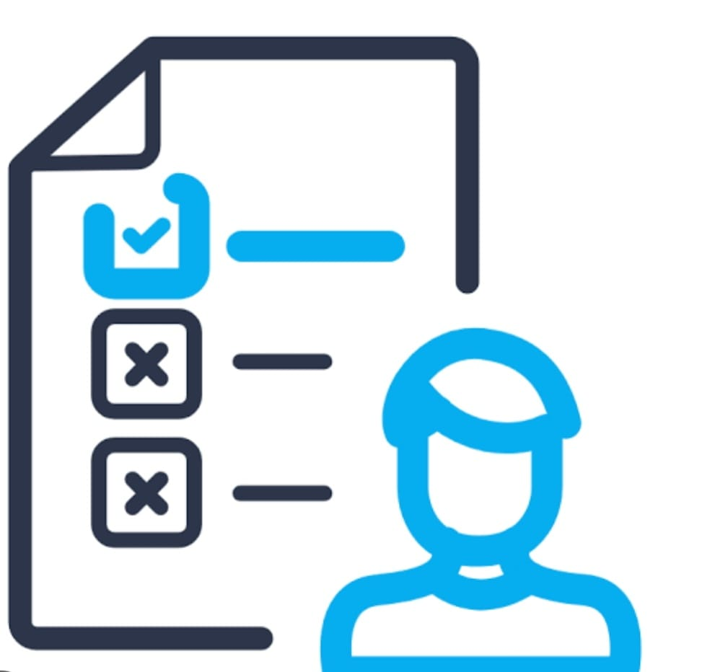
Appointment Booking:
Easy Online Scheduling
Automated
Availability
Patients can conveniently book appointments through our user-friendly online portal, reducing administrative overhead.
The system automatically updates therapist schedules, ensuring availability is always accurate and up-to-date.

Slide 6
User Registration:
Doctor Registration:
User registration involves filling a form with basic details, verifying email address, entering user name and password.
Doctor registraction involves filling form with name and the specialization they have

Slide 7
Patient Information Management
Electronic Medical Record:
Customizable
Forms:
Securely store and access patient medical history, treatment plans, and progress notes.
Easily create and manage personalized intake forms and questionnaires for patients.

Slide 8


Therapist Availability and Scheduling:
1
Manage Schedules
Therapists can easily view and update their availability, block off time for breaks, and accommodate patient requests.
2
Optimize Utilization
The system intelligently assigns patients to available therapists, ensuring efficient resource utilization.
3
Flexible Scheduling
Patients can book appointments based on therapist availability, providing a seamless experience.

Slide 9
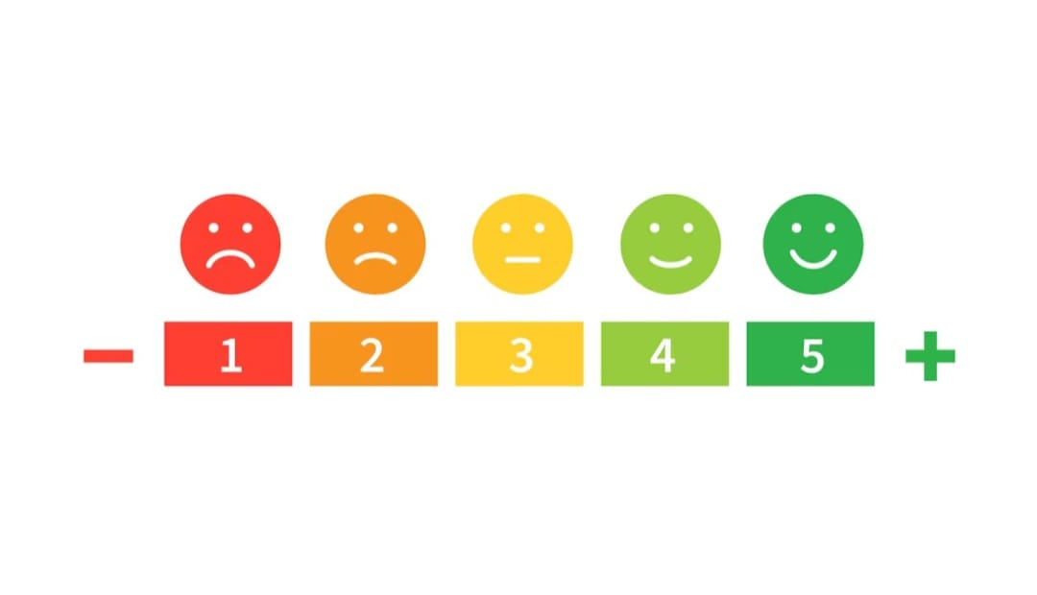
Feedback and Rating:
Feedback is essential for improving services. Encourage users to share their experiences through surveys, ratings, or comments. Act on constructive feedback to enhance user satisfaction, optimize processes, and refine the scheduling system for better performance and user experience.

Slide 10
Algorithm
Initialization:
Import necessary libraries (e.g., Streamlit).
Define classes for Patient, AppointmentScheduler, TreatmentPlan, PatientProgressTracker, and PatientFeedback.
Define functions for user and doctor registration.
Main Function:
Create the main function main().
Set up the Streamlit application title and sidebar menu options.
Based on the user's choice, call the corresponding functions for hospital management, user registration, or doctor registration.

Slide 11
Hospital Management:
Inside hospital_management() function:
Initialize dictionaries to store patient details, appointments, treatment plans, patient progress, and feedback.
Present a submenu for various hospital management options.
Based on the user's selection, prompt for relevant inputs (e.g., patient details, appointment scheduling, treatment plans).
Call appropriate methods of the defined classes to handle the user's actions (e.g., adding patient details, scheduling appointments, adding treatment plans).

Slide 12
User Registration:
Define a function register_user():
Prompt the user for username, email, and password.
On user submission, validate inputs and append user data to the users list.
Provide success feedback upon successful registration.
Doctor Registration:
Define a function register_doctor():
Prompt the user for doctor's name and specialization.
On submission, validate inputs and append doctor data to the doctors list.
Provide success feedback upon successful registration.
Display Functions:
Define functions to display appointment schedules, treatment plans, patient progress, and feedback.
These functions retrieve data from respective class instances and present them using Streamlit components.
Main Execution:
Check if the script is executed directly (__name__ == "__main__").
If true, call the main() function to start the Streamlit application.

Slide 13
Conclusion:
Providing a seamless experience, The conclusion for a physical therapy scheduling system would likely summarize its effectiveness in streamlining appointments, improving patient satisfaction, optimizing resource allocation, and enhancing overall operational efficiency for the clinic or facility. It may also highlight any challenges encountered during implementation and suggestions for further improvements.

Slide 14
Reference:
https://chat.openai.com/
Search engine: goggle

Slide 15


